Slide 1
HR Zone Calculator for Workouts
Presented by:
Rida Rauf
Habiba Ejaz

Slide 2
TABLE OF CONTENT
01 INTRODUCTION | 04 SOLUTION | 05 RESULTS
02 PROBLEM SATEMENT | 03 FLOWCHART | 06 FEATURES

Slide 3
INTRODUCTION
About
A simple tool to calculate heart rate zone and guide workouts.
It help users in keeping track of workout intensity by computing heart rate zones based on the user's age, resting heart rate, and current heart rate.
It is important to exercise at the proper intensity to reach fitness goals like burning fat, improving endurance, or cardiovascular health.
The Goal
Create a program to calculate heart rate zones.
Provide clear guidance on fitness intensity levels.
Make workouts more efficient for users

Slide 4
Problem Statement
Most people don’t know their optimal heart rate zones.
Exercising at the wrong intensity can be ineffective
Exercising either too lightly or too intensely can impact results and safety.
Overtraining can lead to fatigue, while undertraining may not provide desired fitness benefits.
No easy, accessible tools for beginners.
Fitness trackers have been costly and complicated for users.

Slide 5
Applications
Cardiac and Health Monitoring:
Ideal for cardiac rehabilitation, therefore it can be used for heart rate-controlled exercise programs.
Facilitates elderly people maintain safe workout intensity levels.
Wearable Technology Integration:
Logic can be added to wearables such as a fitness band or smart watch, which could allow for heart rate monitoring in real time.
Personal Fitness:
Aids individuals to design specific exercise routine according to heart rate zones.
Help users track intensity to ensure efficient fat burning and cardiovascular fitness.

Slide 6
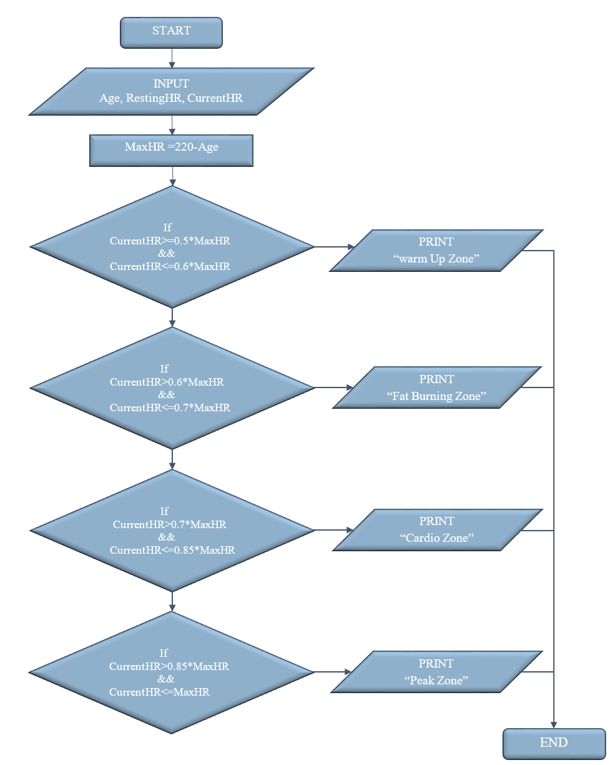
Flowchart
Input: Age, Resting Heart Rate, Current Heart Rate
Calculations: MaxHR = 220 – Age Warm-Up Zone: 50-60% of MaxHR Fat Burn Zone: 60-70% of MaxHR Cardio Zone: 70-85% of MaxHR Peak Zone: 85-100% of MaxHR
Output: Zone classification with a brief message on workout intensity

Slide 7
Conclusion
The Heart Rate Zone Calculator project is an excellent example of the power of combining technology and health science to solve everyday problems.
This program was developed to make fitness monitoring simple and ensure that users make the most out of their workouts without the need for expensive gadgets or complicated processes.
It determines personally tailored heart rate zones, allowing a user to create a customized workout plan based on target goals, which could be weight loss, endurance, or even high-intensity training.
The simplicity of this tool ensures that it can be used with all fitness levels, while accuracy makes it a proper tool to achieve long-term health and wellness goals.

Slide 8
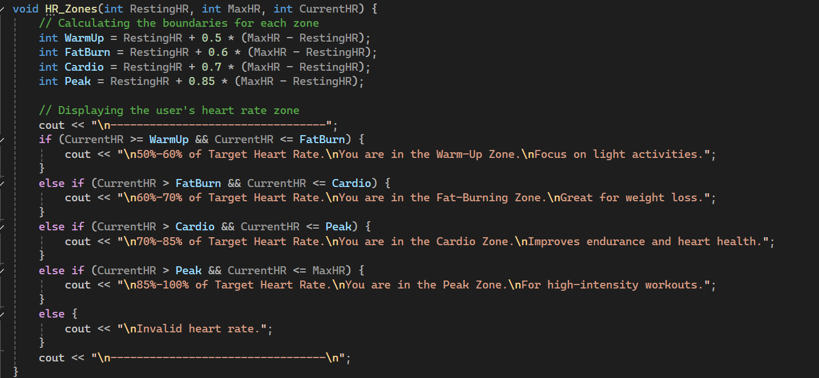
Code Demonstration

Slide 9
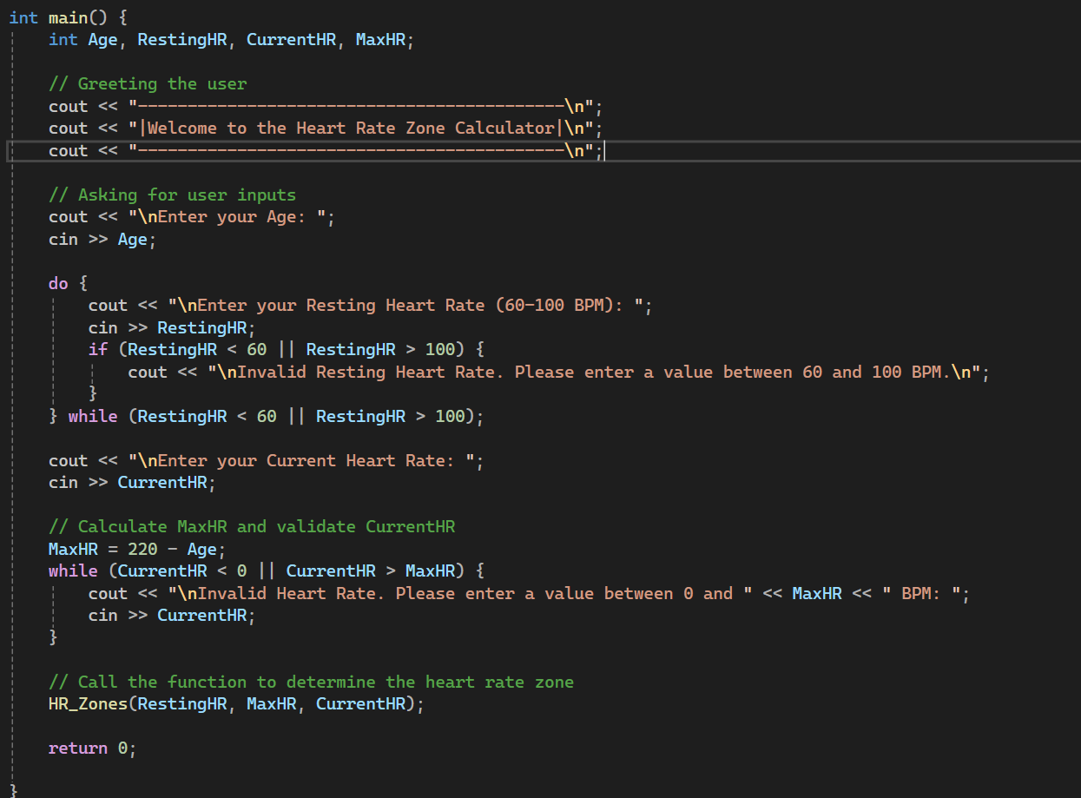

Slide 10
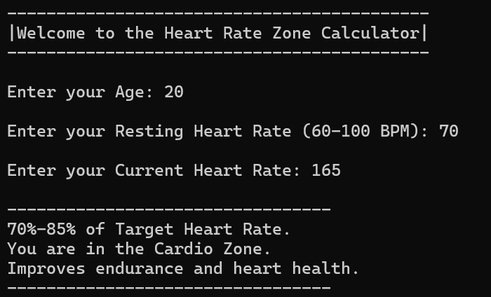
Output
Users information
Age = 20
Resting Heart Rate = 70
Current Heart Rate = 165

Slide 11
THANK YOU!

